Slide 1

ZOMATO BANGALORE
RESTAURANTS
STATISTICS FOR DATA SCIENCE MINI PROJECT
Dhruv Menon- PES1UG19CS143
Guhan.K- PES1UG19CS171
Gauri Gopakumar Menon - PES1UG19CS163
Harshita Vidapanakal - PES1UG19CS185

Slide 2
Introduction
The basic idea of analysing the Zomato dataset is to get a fair idea about the factors affecting the aggregate rating of each restaurant, establishment of different types of restaurant at different places, Bengaluru being one such city has more than 40,000 restaurants with restaurants serving dishes from all over the world. With each day new restaurants opening the industry hasn't been saturated yet and the demand is increasing day by day. In spite of increasing demand, it has become difficult for new restaurants to compete with established restaurants.

Slide 3
1.Exploratory Data Analysis

Slide 4
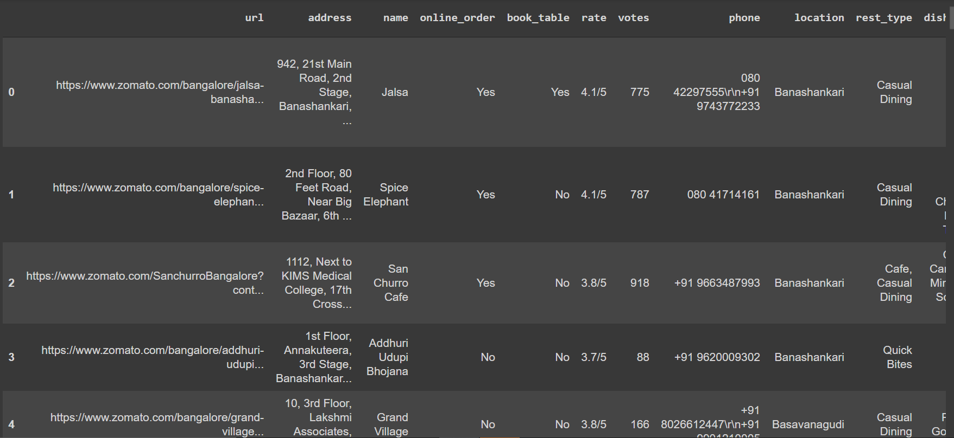
The Dataset - zomato.csv
Number of rows in the dataframe: 51717
Number of columns in the dataframe:17

Slide 5
Column description
url : Zomato url for the restaurants
address : Complete location of the restaurant
name : Name of the restaurant
online_order : Whether restaurant accepts online order or not(Yes or No value)
book_table : Whether restaurant provides option for booking table(Yes or No value)
rating : Restaurants rating on zomato website
votes : Number of individuals who voted for a particular restaurant
phone : Contact details of the restaurant
location : Locality where restaurant is situated
rest_type : Type of restaurants (Categorical value)
dish_liked : Dishes preferred in that restaurant
cuisines : Various cuisines offered by the restaurant
approx_cost(for two people) : Average approximate cost for two people
review_list : Reviews of the restaurant on zomato website
menu_item : Items available in the menu
listed_in(type) : Type of the restaurant
listed_in(city) : Area of the restaurant position

Slide 6
2.Data Cleaning

Slide 7
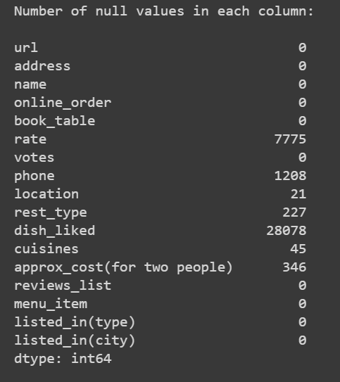
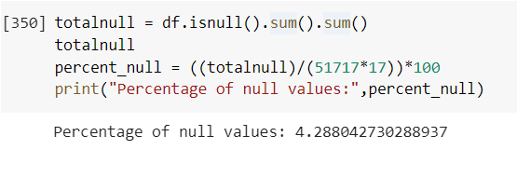
Determining the number and percentage of Missing or Null Values

Slide 8
Cleaning operations performed
Drop columns that are of no value for the data analysis these include:
address, url, phone , menu_item , reviews_list,location
Rename columns (like ‘approx_cos(for two)’, ‘rate’ , ‘listed_in(city)’) for easier access
In the column rating
Replace ‘[ ]’ , ’ ‘ , ‘NEW’, ‘-’ to NaN
Convert them to string type
Remove ‘/5’ from each value to perform operations on the value
Convert all the values to float
Replace the missing values in the columns location,rest_type and cuisines to the mode of their respective columns
Make changes in the column ‘name’ to ensure they’re all in the same format
Replace the missing/Null/Undesirable values in approx_cost to their mean after performing basic cleaning

Slide 9
3.Data Visualization

Slide 10
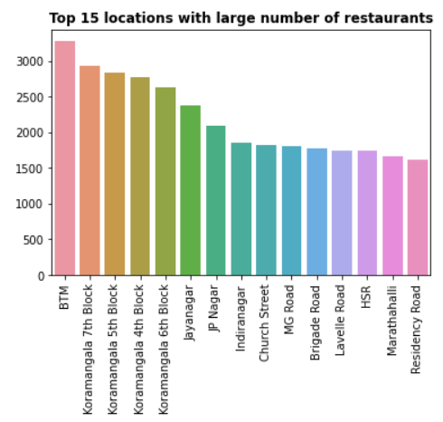
1.Top 10 locations w.r.t number of restaurants
VERTICAL BAR GRAPH
Inference:
It’s quite evident that BTM layout is the locality has the most number of restaurants in the city with more than 3,000 restaurants. It is closely followed by HSR, Koramangala 7th,6th,5th blocks each having approximately 2,500 restaurants.

Slide 11
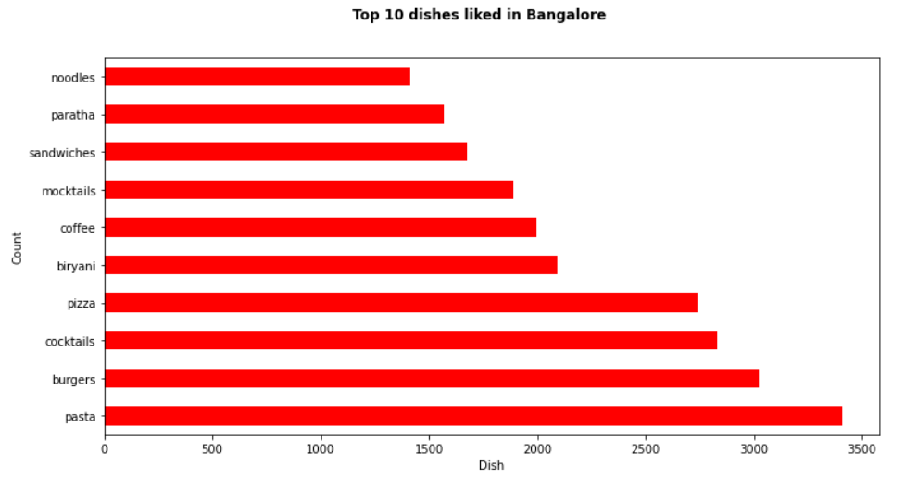
2.DISHES BY POPULARITY
Inference:
Pasta is the most preferred dish by Bangaloreans
HORIZONTAL BAR GRAPH

Slide 12
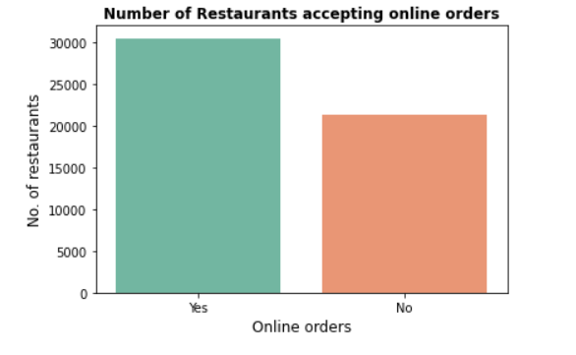
3.RESTAURANTS ACCEPTING ONLINE ORDERS
BAR GRAPH
Inference:
It’s clear that majority of the restaurants accept online orders.
It should be noted that the following data has no Null values so no cleaning’s involved

Slide 13
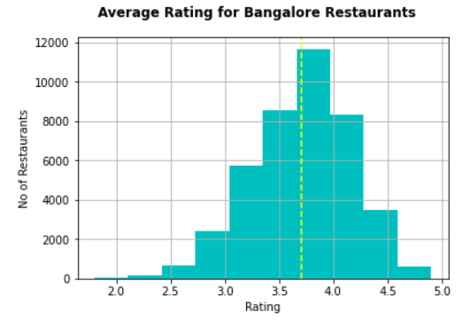
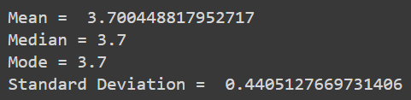
4.RESTAURANTS AVERAGE RATING
HISTOGRAM
Inference
The average rating of restaurants in Bangalore is 3.7/5

Slide 14
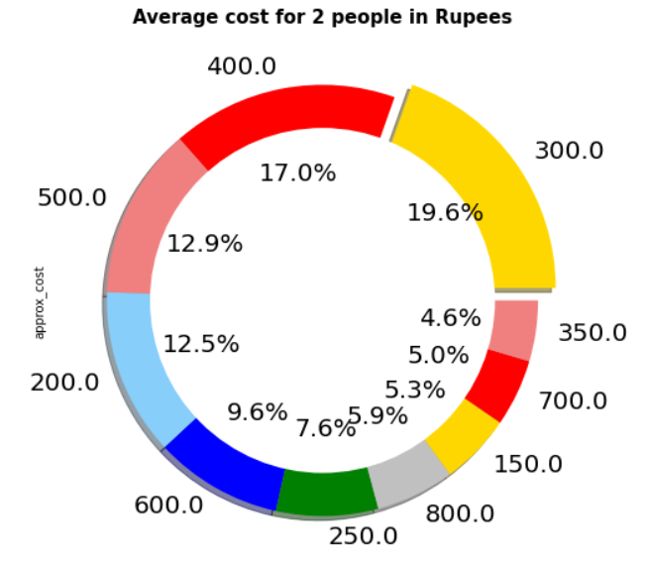
5.AVERAGE COST FOR 2 PEOPLE
DONUT GRAPH
Inference:
We can infer from this graph that the average cost for 2 people in Bangalore restaurants lies between Rs.200 and Rs.500 with 62% of dishes in that price range

Slide 15
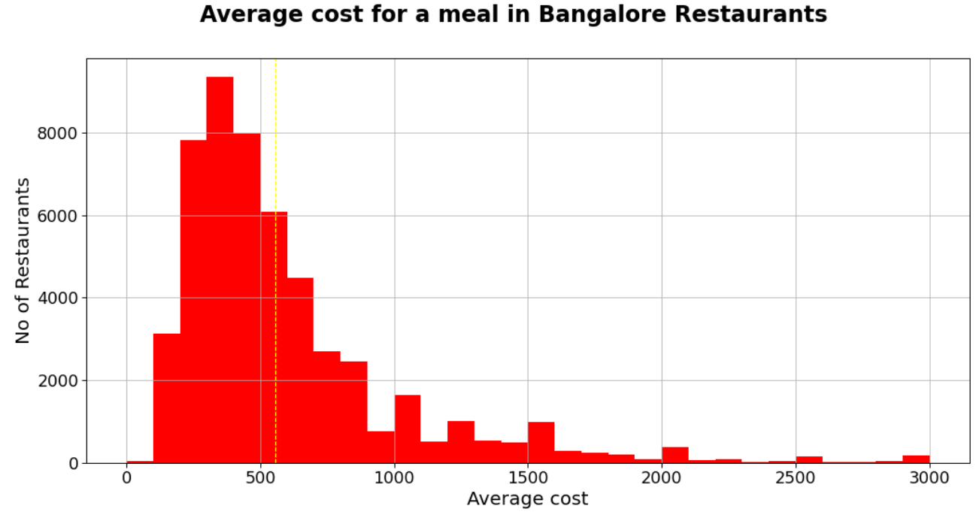
6.AVERAGE COST FOR A MEAL
Inference:
This graph shows that the average cost for a meal in Bangalore restaurants is around Rs. 500.
HISTOGRAM

Slide 16
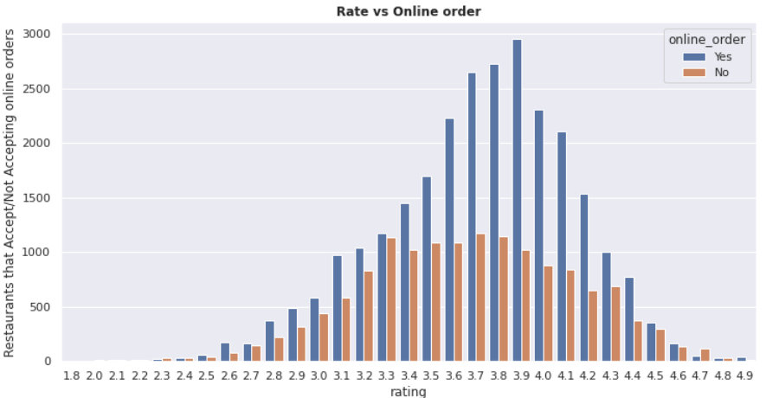
7.RATING VS ONLINE ORDER
Inference
We see that the distribution follows no concrete trend
Majority of restaurants have rating 3.3 to 4.2, no matter whether you can order online or not.
DOUBLE BAR GRAPH

Slide 17
3.Normalization and Standardization

Slide 18
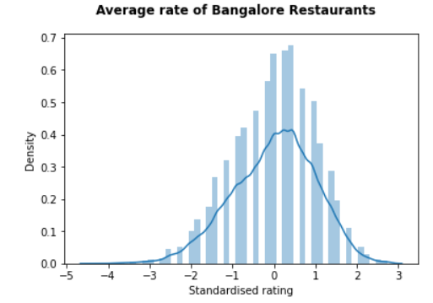
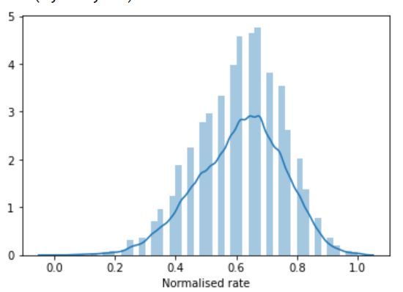
1. Standardised of rating
Data normalization is the process of rescaling one or more attributes to the range of 0 to 1.
The goal of normalization is to change the values of numeric columns in the dataset to a common scale, without distorting differences in the ranges of values.
Data standardization is the process of rescaling of attributes so that they have a mean value of 0 and a standard deviation of 1.
A non-standardized dataset cannot be analyzed if the data is of different scales, so standardizing it transforms it into the above mentioned without actually disturbing the distribution of the dataset.

Slide 19
4.Hypothesis testing

Slide 20
We claim that the minimum average rating of restaurants in Bangalore is 3.75 with a standard deviation of 1.1. To verify this hypothesis, a sample of 50 restaurants is chosen at random. The sample mean is as calculated above. Is there sufficient evidence in the sample to indicate, at a 5% significance level, that the assumption is true?
Hypothesis Testing

Slide 21
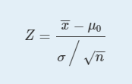
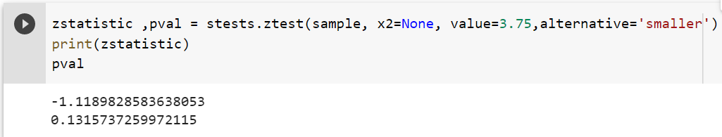
Hypothesis Testing
The sample is large(>30) and the sample standard deviation is known. Thus the test statistic can be calculated as:
Here, H0: μ >= 3.75
Ha: μ < 3.75 @ α = 0.05
We calculate the test statistic.
Here, z-statistic does not fall in the rejection region. p-value > 0.05

Slide 22
Hypothesis Testing
This is a one-tailed test. To be more specific, it's a left tailed test. So there a single critical value -zα = -z(0.005)
which is equal to -1.645. Thus, the rejection rejection is (-inf,-1.645]
The test statistic does not fall in the rejection region Decision : Fail to Reject Ho In the context of our problem our conclusion is:
Conclusion - The mean average rating of restaurants Bangalore is not less than 3.75

Slide 23
5.Correlation

Slide 24
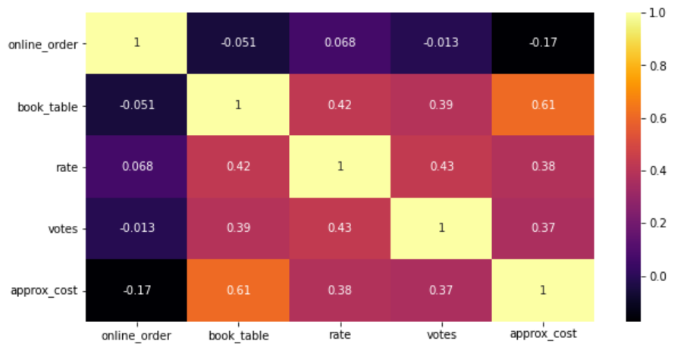
RELATION BETWEEN ALL COLUMNS
From the correlation plot it is clear that approx_cost and book_table have the strong positive correlation. In this case it means that restaurants that provide a option to book table , have a higher approx cost
We can also observe that there is a there is no strong correlation between rate vs approx_cost , rate vs votes .which is inline with the previous observations
We also observe that rate has no correlation with online_order options availability
HEATMAP

Slide 25
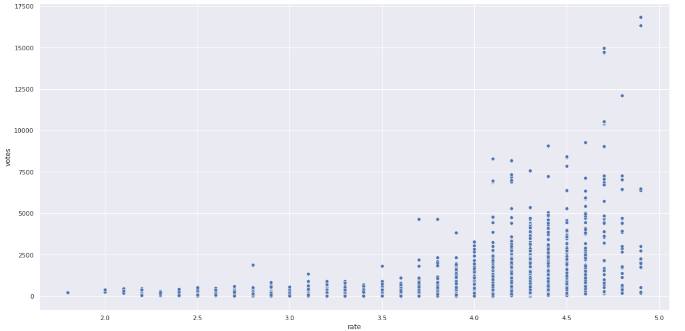
RELATION BETWEEN VOTES AND RATE
SCATTER PLOT

Slide 26
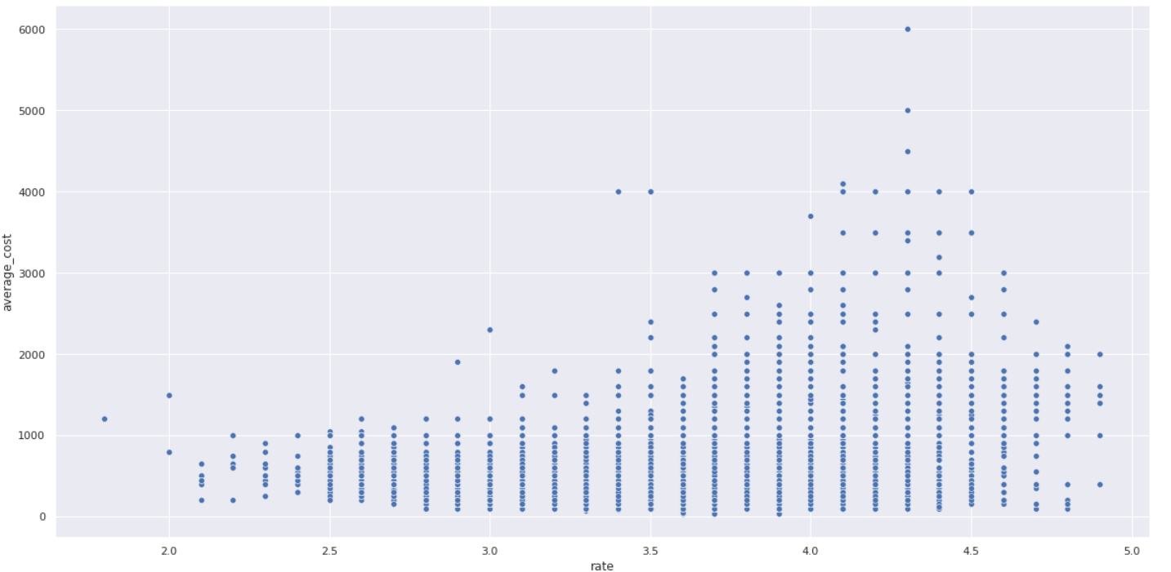
RELATION BETWEEN AVERAGE COST AND RATE
SCATTER PLOT

Slide 27
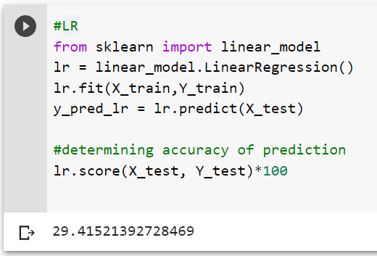
Models
As we observe, the Linear Regression Model’s accuracy is not satisfactory
That’s why,
we implement another model of prediction.

Slide 28
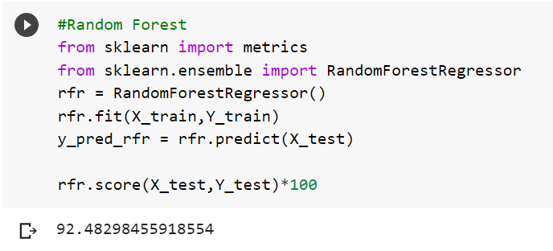
Models
Random Forest regressor model achieves higher accuracy as expected.

Slide 29
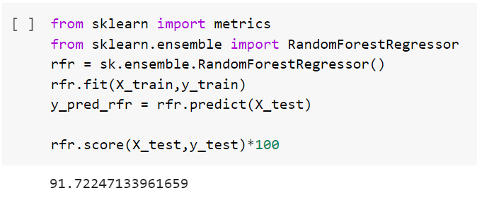
Models
We implement the same the model again but the data undergoes onehot transformation.
As shown above both the times, accuracy of the prediction is approximately normal.

Slide 30
Thank You.

